Slide 1
Patient Portal
Results & Reports

Slide 2
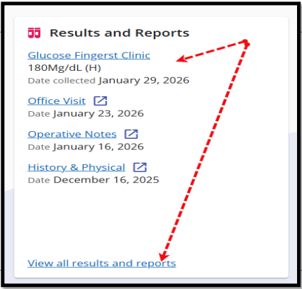
Results & Reports
How to Navigate Results & Reports Section Card
Access from the Dashboard by selecting the Results & Reports section card or from the Main Menu
The Dashboard section card will default to the most recent results and visits. Select “View all results & reports” and it will display only the Results & Reports on your screen

Slide 3
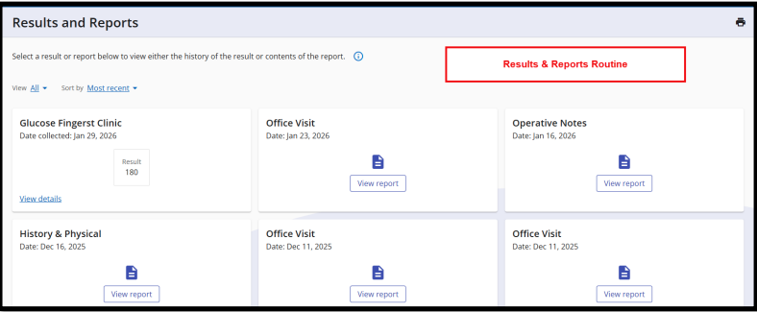

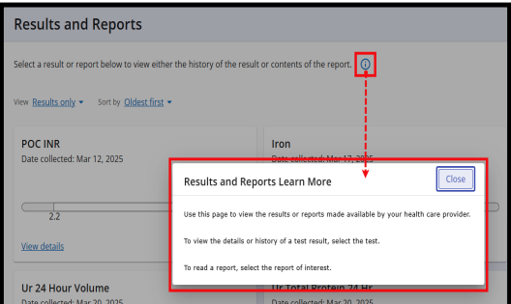
Results & Reports
Blue Indicator
The blue is a clickable indicator that will display more information/instructions

Slide 4
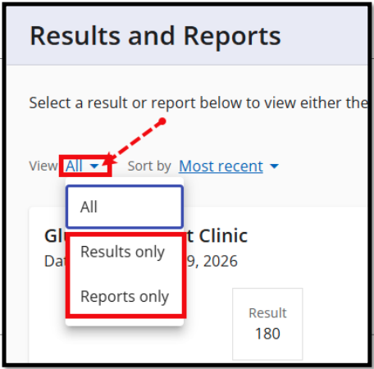
Results & Reports
How to Use Filter Options
Select “Reports only” to only view your reports
Keep the default setting to “All” and view both Results and Reports
Select the drop-down arrow next to “All” and select “Results only” to view only your results

Slide 5
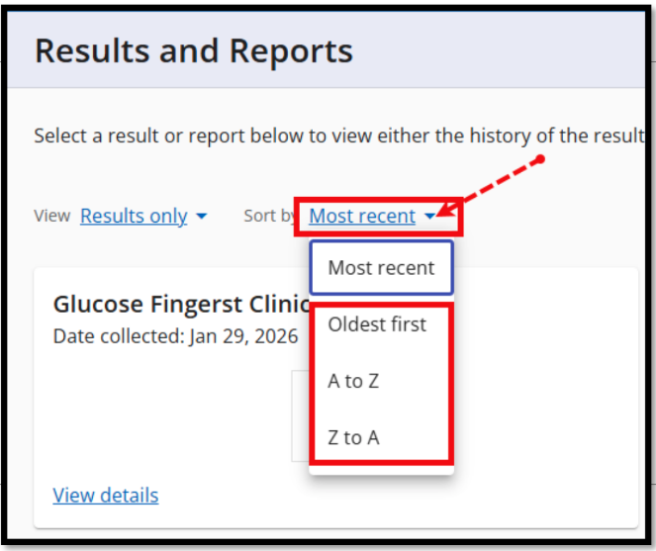
Results & Reports
How to use Filter Options
Select “A-Z” to filter results and reports by alpha “A-Z”
Select “Z-A” to filter results and reports by alpha “Z-A”
Keep the default setting to “Most recent” to view the most recent results and reports that have been completed
Click the drop-down and select “Oldest first” to see historical results and reports

Slide 6
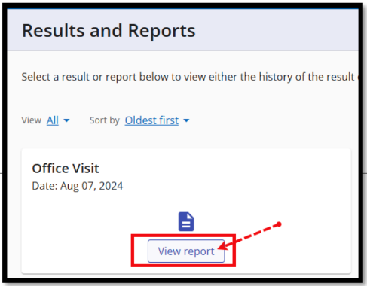
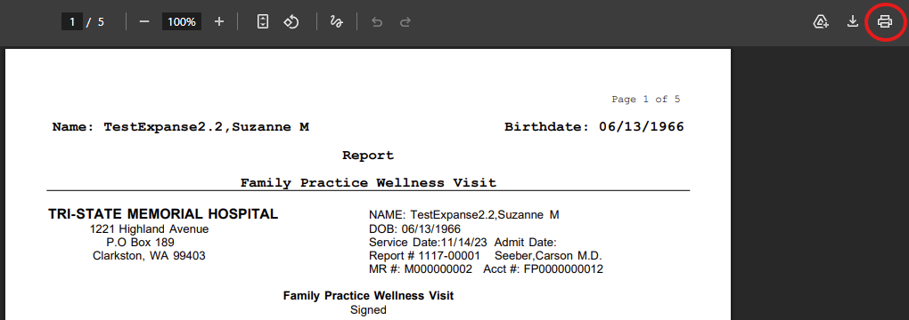
Results & Reports
How to access your full report (s)
Your report will display and can be printed by selecting the print icon
Select the blue link “View report” on the section card

Slide 7
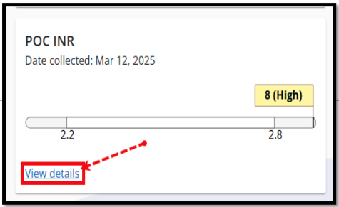
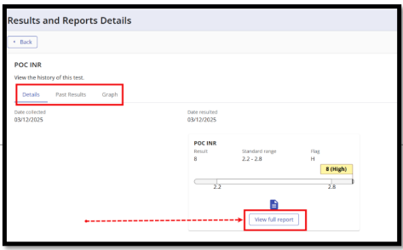

Results & Reports
How to access your result details
Select the blue link “View details” on the section card
Result details will be displayed. Options you can choose from:
Details (default screen). This option provides result details > collection > print option > view full report
Past Results allows to view historical results and view full reports
Graph is a visual that allows you to view trends in your lab results

