Slide 1
My Health Portal

Slide 2
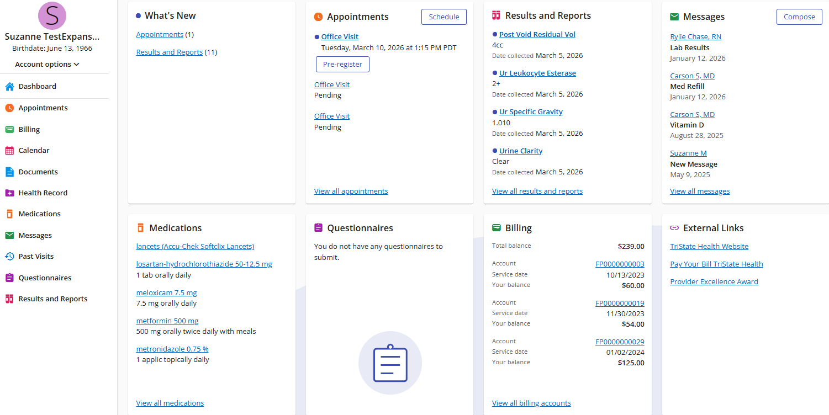
My Health Portal
Welcome to MyHealth patient portal tutorial! Today, you will learn how to navigate the new redesign, review key features, cover what’s new, and changes.

Slide 3
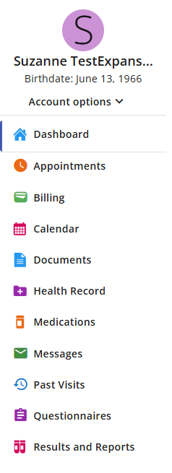
Dashboard/Menu
Key Features
Menu remains stationary no matter where you navigate to
Fewer clicks
Easy to switch from one feature to another
Quick way to return to the Dashboard
MENU

Slide 4
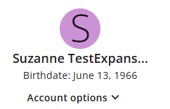
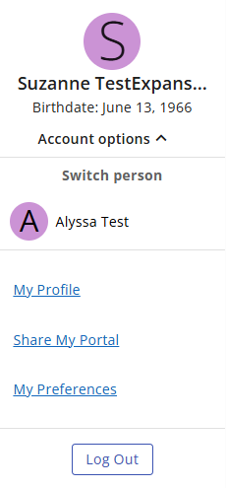
Dashboard/Menu
Account Options
My Profile: Allows you to update
Share My Portal: Allows you to create an invitation to anyone you want to share your Portal with
My Preferences: Allows you to change
Patient Information
Contacts
Shared Access
Communication Preferences
Change your Password
Use the drop-down arrow for more options
Account Options

Slide 5
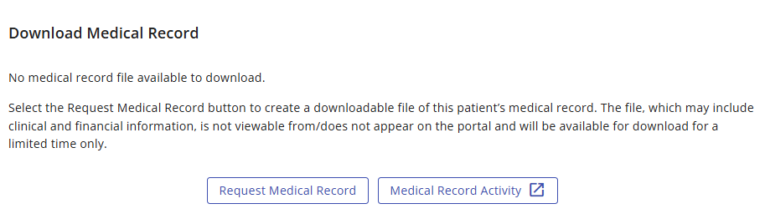
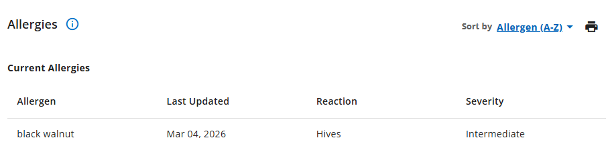
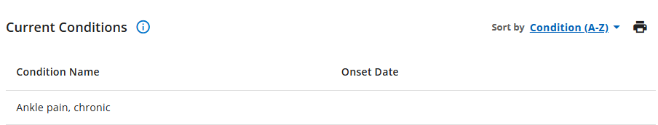
Change to Location of Features
Most Impacted Redesign Feature
Heath Record: Now only contains individuals widgets for
Each Health Record sections has a “Print Icon” that allows users to print an overview of that section
Allergies
Conditions
Immunizations
Download Medical Record
Health Maintenance Items
Changes of Locations of Features
Results & Reports: Have been combined into 1 tab
Visit History: Has been renamed to “Past Visits”
Scanned Documents: Has been renamed to “Documents”.
Profile, Shared Access, Preferences, & Log Out: Now all exist under “Account Options”

Slide 6
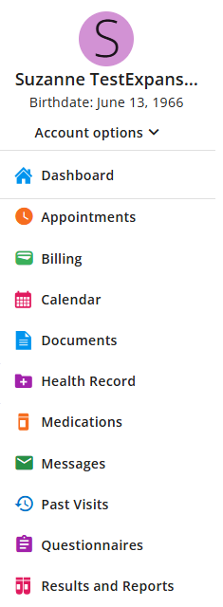
Dashboard/Menu
Menu Options
Dashboard: displays sections and various other features (home screen)
Appointments: request appointment and view upcoming appointments
Billing: payment and balance information
Calendar: allows you to view scheduled appointments on the calendar and add your appointment to your personal calendar
Documents: allows you to view and print your scanned documents, health summary, and letters
Health Record: contains individual sections for allergies, current conditions, immunizations, health maintenance items, and downloadable medical records
To make a payment → Dashboard → External Links → Pay Your Bill TriState Health
Menu Options
Past Visits: includes portions of your medical record for this visit, including allergies, conditions, results and medications (Continuity of Care). This document may be downloaded to your computer by selecting Download Visit Data
Results & Reports: includes various reports such as; office visits, history and physicals, operative notes, and results
Messages: allows you to compose a new workload message to your Provider(s), view your inbox, view your history, and view all your sent messages
Medications: active medications will display on the dashboard. Users can click the blue hyperlink to view more details of the specific medication or can “view all medications”

Slide 7
Dashboard/Menu
Dashboard
Quick snapshot of various data
Action buttons (allows users to conduct activity)
Example:
Requesting an appointment or composing a secure message
Upon logging in, users will be brought to a new dashboard feature which displays links and icons for various functions.

Slide 8
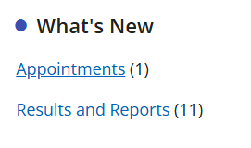
Dashboard Highlights
DASHBOARD HIGHLIGHTS
The “What’s New” feature will display on the Dashboard when any new items are updated
Any new appointment that is scheduled, medications, or any updated results and/or reports
Example:

Slide 9
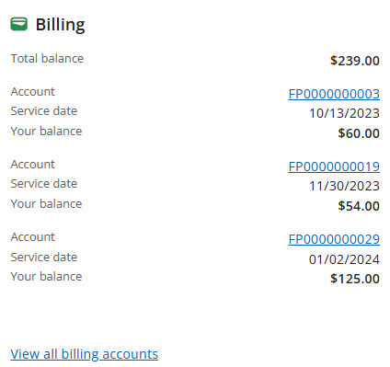
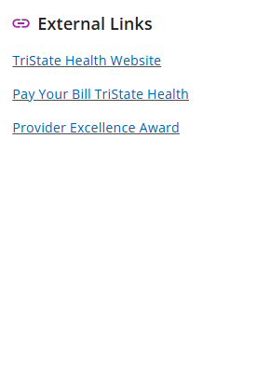
Dashboard/Highlights
DASHBOARD HIGHLIGHTS
External Links: from the Dashboard - click the blue hyperlink “Pay Your Bill TriState Health” to take you to an external site
------------------------------------------
Billing: billing tab allows the users to view Total balance. Click the blue hyperlink to view all billing accounts. The billing tab will also display helpful information on how to pay your bill

